Slide 1
CRUDE OIL PRICE PREDICTION
Team Id:
PNT2022TMID51453

Slide 2
PROBLEM STATEMENTS
Crude oil price prediction is a challenging task in oil producing countries. Its price is among the most complex and tough to model because fluctuations of price of crude oil are highly irregular, nonlinear and varies dynamically with high uncertainty.

Slide 3
PROPOSED SOLUTION
According to economic theory, the price of crude oil should be easily predictable from the equilibrium between demand and supply, wherein demand forecasts are usually made from GDP, exchange rates and domestic prices, and supply is predicted from past production data and reserve data.

Slide 4
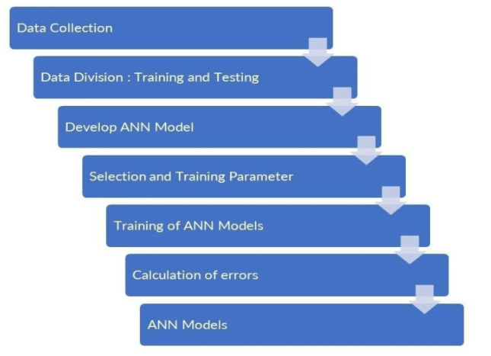
ARCHITECTURE

